Slide 1

State Accounting
Business User Group (BUG)
Tuesday, February 25, 2020
9:00 AM – 11:30 AM
1526 K Street basement, Training Room/Development Center

Slide 2
Agenda
Announcements
Presentations
General Announcements
W4 Updates
Object 521400 on OCIO IBTs
Use AS.State Accounting email for requests, do not send to individual email
Deactivation of user IDs upon employee termination
State Accounting website/Training Guides/Accounting Manual
Fixed Assets
Received Not Vouchered
Construction in Progress (CIP)
Fund Request Forms
Audit Responses and Exit Conferences
DAS Staff – Who do I contact?

Slide 3
Announcements
General Announcements
W4 Updates
Feedback Forms/Questions
Object 521400 on OCIO IBTs
Use AS.State Accounting email for requests, do not send to individual email
Deactivation of user IDs upon employee Termination

Slide 4
Feedback Forms and Questions
Email Sheryl.Hesseltine@Nebraska.gov
Submit Feedback forms

Slide 5
OCIO IBTs
All OCIO IBTs should be coded to 521400 CIO Charges
Only exception is for a Fixed Asset (58****) purchase by OCIO for an agency
  Memo would accompany the IBT giving the agency detail on the purchase

Slide 6
Batch in ERROR status
Run report R5514001 ‘G/L Post Budget Failure Report’
  Before contacting State Accounting for assistance
  Gives you error code and explanation
  Menu path: Accounting>Manage Journal Entry>JE Review/Approve/Post

Slide 7
Requests for State Accounting
Always send requests through as.stateaccounting@nebraska.gov
  If you are used to working with a specific person you are welcome to cc them
  Requests that are sent only to a specific teammate could easily get missed or delayed

Slide 8
Deactivation of user IDs upon employee termination
http://das.nebraska.gov/personnel/user_guides/ewoc/terminateanemployee.pdf
Employee Work Center

Slide 9
Questions?

Slide 10
Kevin
State Accounting Website/Training Guides/Accounting Manual

Slide 11
Break

Slide 12
Fixed Assets
Andrea Kiichler

Slide 13
Fixed Assets
Fixed Asset Facts
Creating Master Record
Posting Costs and Reports
The Big Picture

Slide 14
Fixed Asset Facts
Created by payment to vendor by receipt from PO, JE, or J9
Coded to “58” Object Code
Payments posted to General Ledger, copy to Fixed Asset module
Fixed Assets= $5000 <
Exception: Firearms, all must be capitalized

Slide 15
Master Record
Beginning of Life for asset
*Tag number
*Cost Account
*Date acquired
*User defined Category Codes
*Text descriptions/remarks
Must be created for all Fixed Assets
E1 Guide for Creating Asset Master

Slide 16
Posting Costs & Checking it twice!
Receipting and Posting Costs = must establish relationship in same month
Splitting the Cost for Multiple Assets = Journal Entry (same month)
Friendly suggestion: no FA receipting last week of month
Allows time for Fixed Asset Coordinator to review receipts & JE’s for splits
E1 Guide for Posting & Split Asset Transaction Posting

Slide 17
Fixed Asset Reports
Fixed Asset No Cost Integrity Report: listing of the Fixed Assets that have master records (tag #’s), but no costs assigned.
Unposted Fixed Asset Report: costs exist because coded to a fixed asset object code (58), but not attached to an asset master record (tag #)
No Cost report comparison to Unposted Report-any matches?
Monthly review of these reports keeps you current
Must be cleared end of each month, and at FYE

Slide 18
Fixed Asset Issues
Oops! I didn’t post FA cost to asset in the same month!
*JE instruction and documentation
*documentation is invoice/PO/Packing Slips.
How do I know when to Pass on a cost?
*Most of the time, JE Debit side of transaction, but not always. Review cost of your assets first
Uh Oh…..I just don’t get it! HELP!
*Email Sheryl: Sheryl.Hesseltine@Nebraska.gov

Slide 19
Construction Commitments
&
Construction in Progress (CIP)

Slide 20
Construction Commitments
Signed contract, with a commitment to pay a specific amount over the course of multiple years.
Construction in Progress (CIP)
Activity on specific projects for the year
Includes New buildings, building additions, land improvements, software, IT projects, Infrastructure, etc.
$100,000 < reported on CAFR
Notes:
Definition:

Slide 21
Reporting to DAS-State Accounting
DAS will request Construction Commitment Info and CIP info at beginning of Fiscal Year
Agencies are responsible for tracking this information
Forms will be on State Accounting Website and sent to Agencies
(work in progress-feedback?)
Notes:
Forms are a work in progress and are to provide guidance to help agencies track information.
We want to make the process easy for you to report Construction Commitments and CIP info.

Slide 22
Notes:
*Good starting point to track all contracts.
*Overview of what your agency is expected to pay, or committed to pay overall
*Copies of Contract, AIA documents, could be other documents such as internal agreements, agency contracts, MOU’s, PO’s, etc.

Slide 23
Notes:
Project Type: Can be Building, building improvements, Building additions, Software, It, infrastructure, etc.
Additions: This is all fiscal activity that occurred during the year. If over $100,000 need to report for CAFR purposes
Deletions: This is when the money is moved from CIP to a working fixed asset via a JE; depreciation will begin
Beginning Balance: this should match your ending balance from the prior year

Slide 24
Building Additions & Improvements
Additions: capitalized when square footage added to existing building & accumulated costs are $100,000 or greater
Improvements: capitalized when project enhances functionality of building by effectiveness or efficiency, or extends the life of the building, and the accumulated costs are $100,000 or greater. These improvements do not add square footage to the existing building
http://das.nebraska.gov/accounting/manual/account_manual.html#28

Slide 25
Construction In Progress
For large projects (new construction, building additions, or building improvements), with multiple progress payments, the payments should be coded to 587500 – Construction-In-Progress
When a new construction project is complete and all costs have been accumulated, the agency should complete the Building Inventory Form and send it to DAS Building Division
Building Division staff will create an asset tag number and enter the asset into EnterpriseOne using Item Code 12
The agency will create a Journal Entry to attach the costs to the new tag number by debiting 581200 and crediting 587500 and entering the tag number in the appropriate column on the Journal Entry
Building Additions & improvements under $100,000 should be expensed

Slide 26
Questions?

Slide 27
Received Not Vouchered

Slide 28
Received Not Vouchered
Object account 211700
Agency receives against a purchase order. Debit is to the expense account, credit is to 211700; liability account
When the agency processes the payment voucher, the debit is to clear 211700 and the credit is to Due To Vendor
Problems can occur in this object during both the receiving and payment processes
The Received Not Vouchered report is used to identify any problems in this liability account

Slide 29
Received Not Vouchered
E1 Menu :
Accounting > Inquiries & Reports > Accounting Reports > Received-Vouchered Reports > Received Not Vouchered Report
Purchasing – Agencies > Inquiries & Reports > Accounts Payable Reports > Received Not Vouchered Report

Slide 30
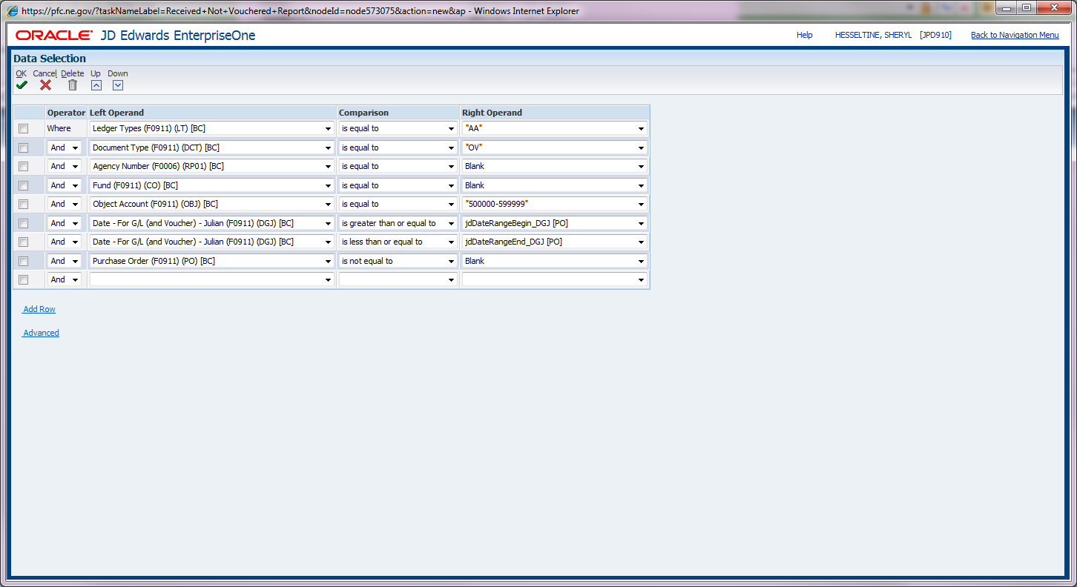
Received Not Vouchered

Slide 31
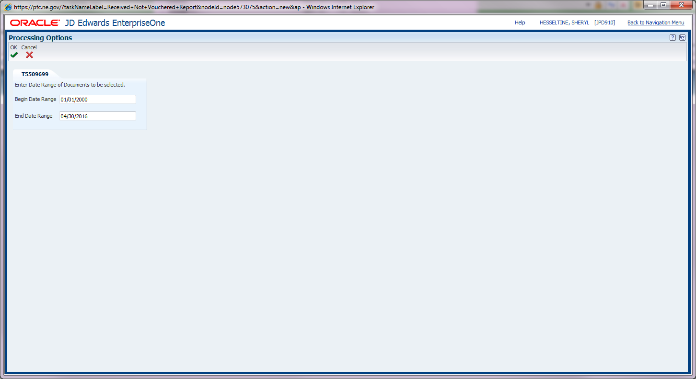
Received Not Vouchered
Make sure
“begin date range” is
ALWAYS 1/1/2000

Slide 32
Received Not Vouchered
Correcting Received Not Vouchered account when Vouchered without PO
  Reverse Receipt the purchase order
  http://das.nebraska.gov/nis/training_manuals/proc/L08_T02_01_Reversing_Receipts/Training%20Guide/Reversing%20Receipts_TRAIN.pdf
  Cancel the Purchase Order
  http://das.nebraska.gov/nis/training_manuals/proc/L02_T01_01_Revising_a_Procurement_Document/Training%20Guide/Revising%20a%20Procurement%20Document_TRAIN.pdf

Slide 33
Received Not Vouchered
If your agency’s Received Not Vouchered report shows small variances, which are often due to rounding differences or paying a different amount than the purchase order, contact State Accounting for assistance in the correction.
AS.StateAccounting@Nebraska.gov
Please note that before processing a payment voucher for a purchase order, you must be sure that the O batch (receiving batch) has posted first

Slide 34
Questions?

Slide 35
Break

Slide 36
Fund Request Forms
Shannon Muffly

Slide 37
Fund Request Forms
Header information
Sections
Parent/Child Fund
Statutory Authority
Routing procedure

Slide 38
Header Information
Agency Name
Agency Number
Fund Name
  Character limit
  Statutory Authority
Statutory Authority

Slide 39
Sections
Add
Change
Terminate
  Can only terminate if Administratively created, otherwise State Statue must say it can be terminated
  No Asset or Liability account balances

Slide 40
Parent/Child
Parent
  Required by Statutory Authority – includes name
Child
  Not required by Statutory Authority

Slide 41
Statutory Authority
LB or State Statue requires you to set up the fund
Name must match (or be abbreviated for spacing limit)

Slide 42
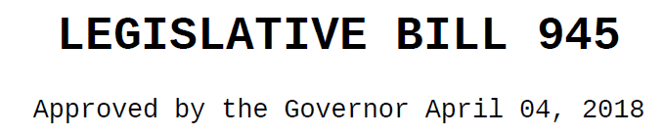
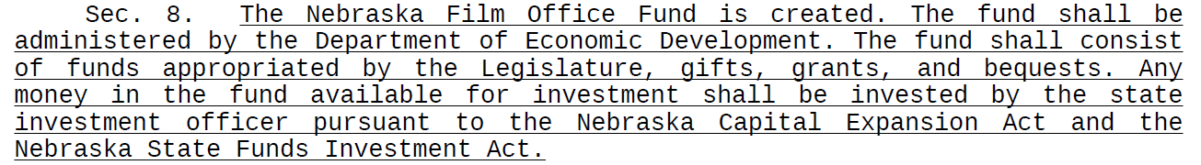

Slide 43
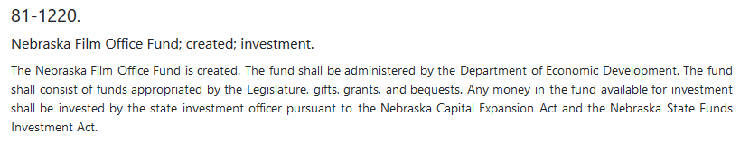

Slide 44
Routing Procedure
Agency Director signature
DAS Budget Analyst
DAS Administrator
Financial Reports Team
Email and documentation back to agency

Slide 45
Questions?

Slide 46
Audit Responses
DAS requests updates for CAFR
APA requests for audits
Federal agencies

Slide 47
Exit Conferences
Send meeting invites to:
  Sheryl Hesseltine
  Chad Pinger

Slide 48
DAS Staff
Who should we contact????
http://das.nebraska.gov/accounting/contacts.html

Slide 49
Questions?

Slide 50
Feedback Forms

Slide 51
Questions?
http://das.nebraska/accounting
  Accounting Policies; state accounting manual
Contact Info
  sheryl.hesseltine@nebraska.gov, 402-471-0610
  shannon.muffly@nebraska.gov, 402-471-0616
  kevin.le@nebraska.gov, 402-471-0622

